Slide 1


Memory allocation in C

Slide 2
Contents
Introduction & Background
Implementation
Project Management
Results
Conclusion
References

Slide 3
Introduction
What is C used for and what are the advantages of this language
The importance to now how C manage memory
The importance of managing memory now a days

Slide 4
Aim of this project
The objective of this project is to enrich the knowledge and to be more comfortable with the use of the programing language C and have a better comprehension of how it works in terms of the memory management

Slide 5
Objectives
Presenting the way that the compiler works and the differences with the Interpreter
How variables works in C and do some experiments whit them to have some conclusions.
Understand what are pointers and how they can help us to better understand how C works with memory
Explore the malloc and calloc commands and do some experiments with them

Slide 6
Research
Online compiler (replit)
GCC(GNU compiler collection)

Slide 7
Methods used in the research
Fundamental
Empirical

Slide 8
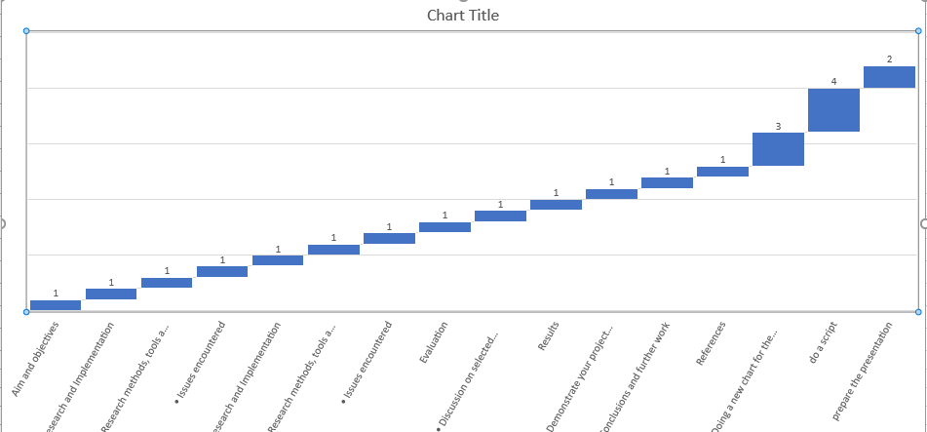
Project Management: waterfall chart

Slide 9
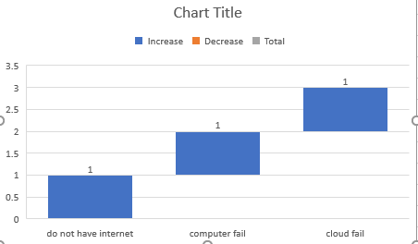

Slide 10
Why is C known for?
Minacious
With no waste
Fast

Slide 11
Types of variables and their use of memory
Char
Int
Doublle
Float

Slide 12
Pointers
What are pointers?
How pointers work
Why are they so important

Slide 13
conclusion
Why I chosed this work
How memory is more precious now a days

Slide 14
references
The Importance of Memory Management b. Available from: https://www.opensourceforu.com/2015/12/the-importance-of-memory-management/
Pointers in C Programming: What is Pointer, Types & Examples c. Available from: https://www.guru99.com/c-pointers.html
BAILEY, T., 2005. An Introduction to the C Programming Language and Software Design.

